Slide 1
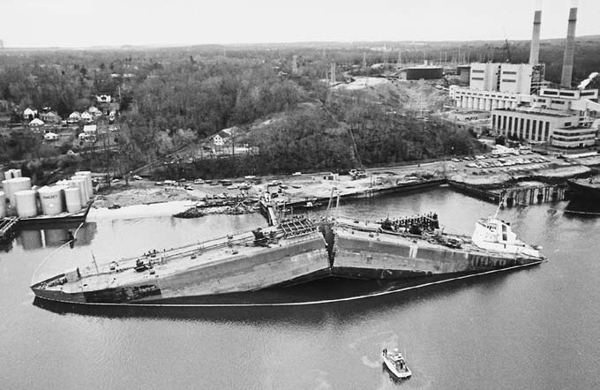
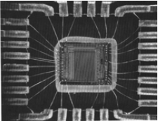
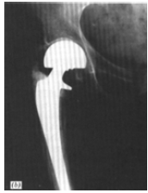
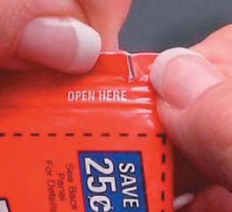
Failure: Fracture, Fatigue and Creep
Ship-cyclic loading from waves
Hip implant-cyclic
loading from walking
Computer chip-cyclic thermal loading
The failure of engineering materials is an undesirable event: human lives that are put in jeopardy,
-economic losses,
-interference with the availability of products and services.
The usual causes:
improper materials selection
processing and inadequate design of the component
its misuse
a minimal force required to tear the package open
It is the responsibility of the engineer to anticipate and plan for possible failure and, in the event that failure does occur, to assess its cause and then take appropriate preventive measures against future incidents

Slide 2
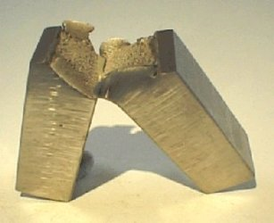
FRACTURE
Fracture: Separation of a body into pieces due to stress, at
temperatures below the melting point.
Steps in fracture:
1- crack formation
2-crack propagation
Two fracture modes can be defined - ductile or brittle depending on the ability of material to undergo plastic deformation before the fracture
• Ductile fracture - most metals (not too cold):
Extensive plastic deformation ahead of crack
Crack is “stable”: resists further extension unless applied stress is increased
• Brittle fracture - ceramics, cold metals:
Relatively little plastic deformation
Crack is “unstable”: propagates rapidly without increase in applied stress
Ductile fracture is preferred in most applications.

Slide 3
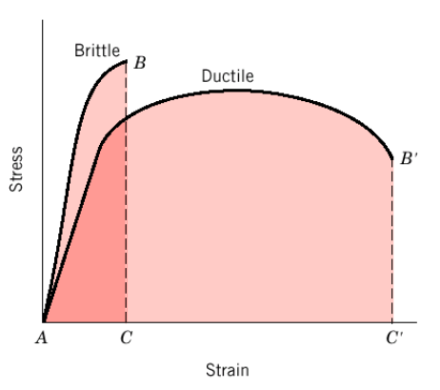
Brittle vs. Ductile Fracture
Ductile materials - extensive plastic deformation and energy absorption (“toughness”) before fracture
Brittle materials - little plastic deformation and low energy absorption before fracture

Slide 4
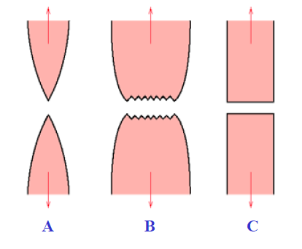
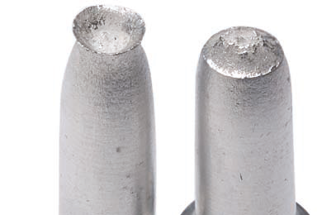
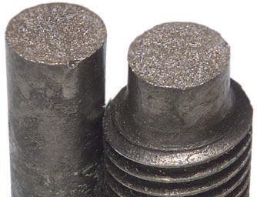
Brittle vs. Ductile Fracture
Cup and cone fracture in aluminum. (ductile B)
Brittle fracture
in a mild steel
A. Very ductile, soft metals (e.g. Pb, Au) at room temperature, other metals, polymers, glasses at high temperature. These highly ductile materials neck down to a point fracture, showing virtually 100% reduction in area.
B. Moderately ductile fracture, typical for ductile metals. fracture is preceded by only a moderate amount of necking.
C. Brittle fracture, cold metals, ceramics

Slide 5
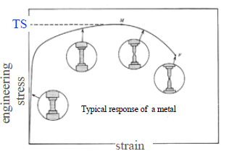
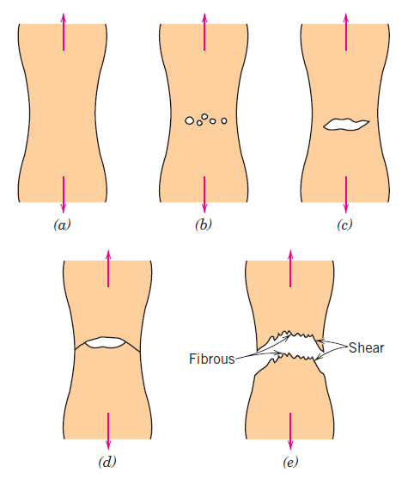
DUCTILE FRACTURE
The most common type of tensile fracture profile for ductile metals:
Crack
grows
90° to
applied
stress
a. Neck formation (subsequent
deformation is confined to the
neck).
b. Small cavity (microvoids) formation.
c. Further deformations leads to
coalescence of voids into a crack.
d. Crack propagation.
e. Fracture. ) «cup-and-cone fracture»
45° - maximum
Shear stress

Slide 6
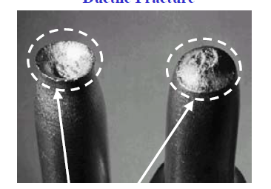
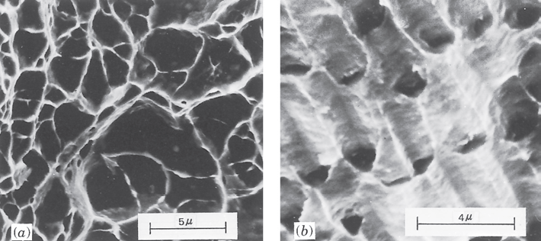
DUCTILE FRACTURE
Typical Cup-and-Cone fracture in ductile Al
Scanning electron fractograph showing spherical dimples characteristic of ductile fracture resulting from uniaxial tensile loads. 3300X.
Scanning electron fractograph showing parabolic-shaped dimples characteristic of ductile fracture resulting from shear loading. 5000x.
Scanning Electron Microscopy: Fractographic studies at high resolution. Spherical «dimples» correspond to micro-cavities that initiate crack formation.

Slide 7
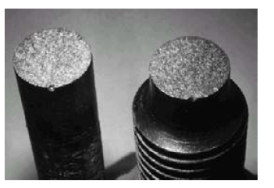
BRITTLE FRACTURE
Brittle fracture takes place without any appreciable deformation and by rapid crack propagation
Crack propagates nearly perpendicular to the direction of the applied stress
Crack often propagates by cleavage – breaking of atomic bonds along specific crystallographic planes (cleavage planes).
Brittle fracture in a mild steel
‘‘rock candy’’ appearance

Slide 8
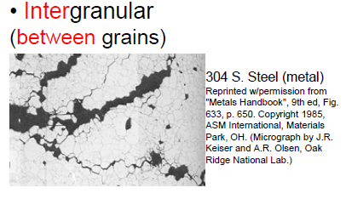
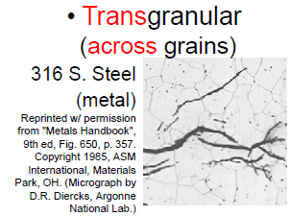
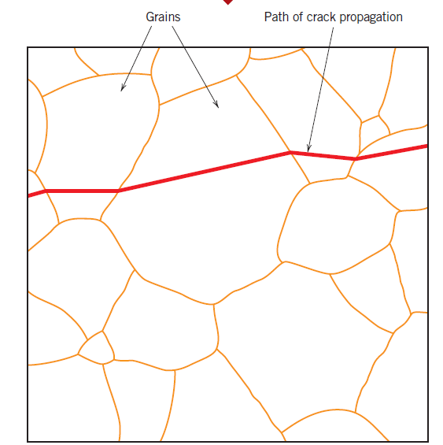
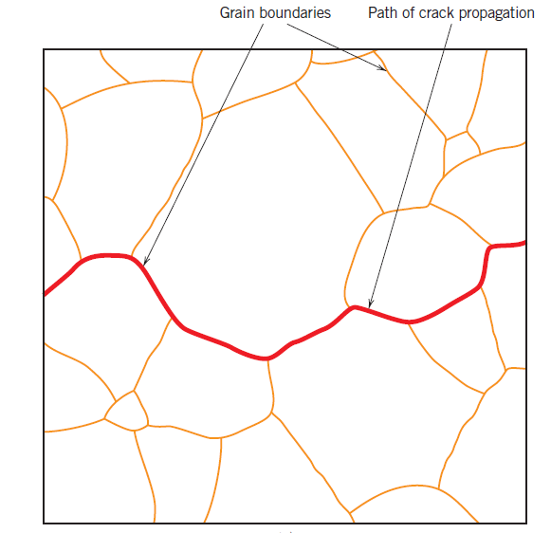
BRITTLE FRACTURE
A. Transgranular fracture: Fracture cracks pass through grains. Fracture surface have faceted texture because of different orientation of cleavage planes in grains.
B. Intergranular fracture: Fracture crack propagation is along grain boundaries (grain boundaries are weakened or embrittled by impurities segregation etc.)

Slide 9
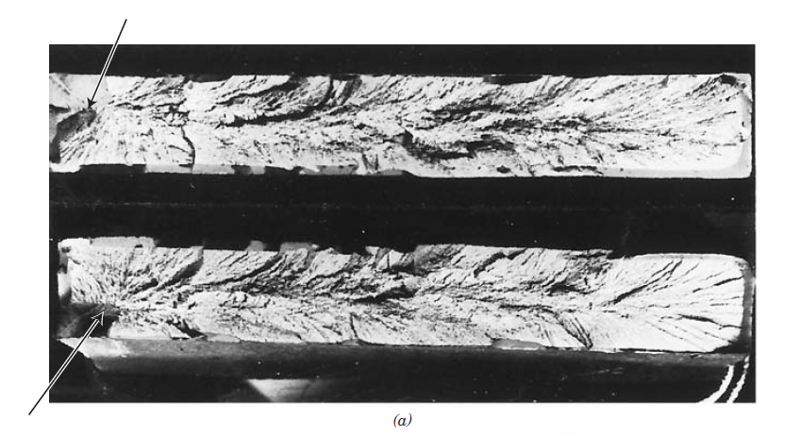
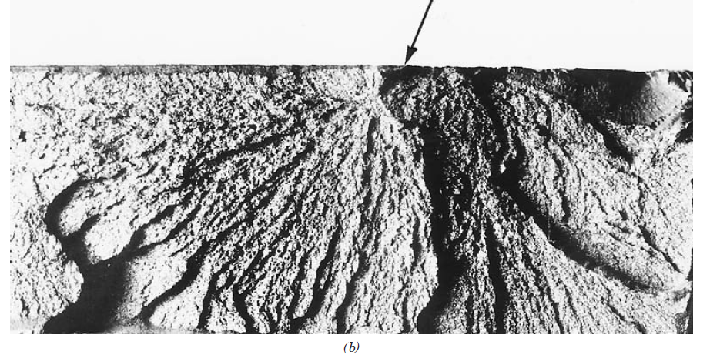
BRITTLE FRACTURE
Fracture surfaces of materials that failed in a brittle manner will have their own distinctive patterns; any signs of gross plastic deformation will be absent.
Chevron marks
From brittle fracture
Origin of crack
Fan-shaped
ridges
coming from
crack

Slide 10
MICROSTRUCTURAL FEATURES OF FRACTURE IN CERAMICS, GLASSES
A. CERAMIC
In ceramic materials, the ionic or covalent bonds permit little or no slip.
failure is a result of brittle fracture.
Most crystalline ceramics fail by cleavage along widely spaced, closely packed planes.
The fracture surface typically is smooth, and frequently no characteristic surface features point to the origin of the fracture
The fracture
surface of Al2O3, showing the cleavage faces (x1250),

Slide 11
MICROSTRUCTURAL FEATURES OF FRACTURE IN CERAMICS, GLASSES
B. GLASSES
Glasses also fracture in a brittle manner.
Frequently, a conchoidal fracture surface is observed. This surface contains a very smooth mirror zone near the origin of the fracture, with tear lines comprising the remainder of the surface.
The tear lines point back to the mirror zone and the origin of the crack, much like the chevron pattern in metals.
the fracture surface of glass,
showing the mirror zone (top) and tear lines characteristic of conchoidal fracture

Slide 12
MICROSTRUCTURAL FEATURES OF FRACTURE IN CERAMICS, GLASSES
C. POLYMERS
Polymers can fail by either a ductile or a brittle mechanism.
Below the glass temperature (Tg), thermoplastic polymers fail in a brittle manner—much like a glass. Likewise, the hard thermoset polymers, whose structure consists of inter-connected long chains of molecules, fail by a brittle mechanism.
Some plastics whose structure consists of tangled but not chemically cross-linked chains, however, fail in a ductile manner above the glass temperature, giving evidence of extensive deformation and even necking prior to failure.
The ductile behavior is a result of sliding of the polymer chains, which is not possible in glassy or thermosetting polymers. Thermosetting polymers have a rigid, three-dimensional cross-linked structure

Slide 13
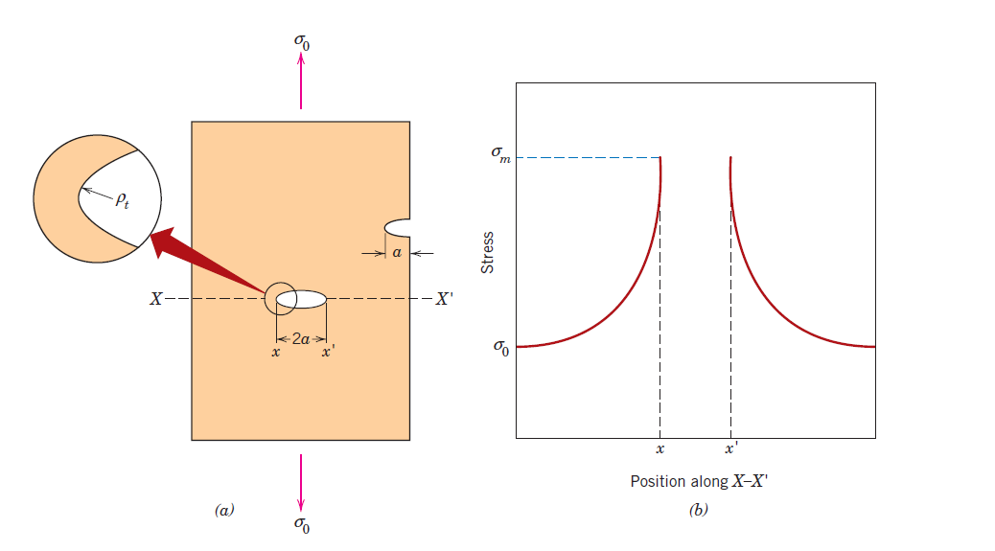
PRINCIPLES OF FRACTURE MECHANICS
quantification of the relationships between material properties, stress level, the presence of crack-producing flaws, and crack propagation mechanisms.
Stress Concentration
The measured fracture strengths for most materials are significantly lower than those predicted by theoretical calculations which are based on atomic bonding energies.
Because :
the presence of microscopic flaws or cracks that always exist under normal conditions at the surface and within the interior of a body of material.
these flaws are called stress raisers.
(a) The geometry of surface and internal cracks. (b) Schematic stress profile
along the line X–X in (a), demonstrating stress amplification at crack tip positions.

Slide 14
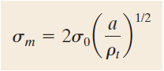
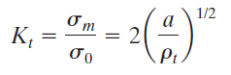
PRINCIPLES OF FRACTURE MECHANICS
Stress Concentration
Flaw/cracks can amplify or concentrate stress!
For a long crack oriented perpendicular to the applied stress; the maximum stress σ_{m} near the crack tip is:
σ₀ : the nominal applied tensile stress,
ρ_{t} :the radius of curvature of the crack tip
a : the half-length of the crack
For a relatively long microcrack that has a small tip radius of curvature, the factor (a/ρt)^{1/2} may be very large. This will yield a value of σ_{m} that is many times the value of σ₀
The stress concentration factor: K_{t}
a measure of the degree to which an external stress is amplified at the tip of a crack.

Slide 15
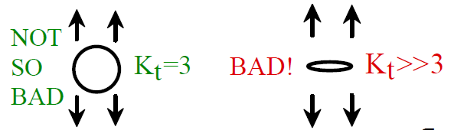
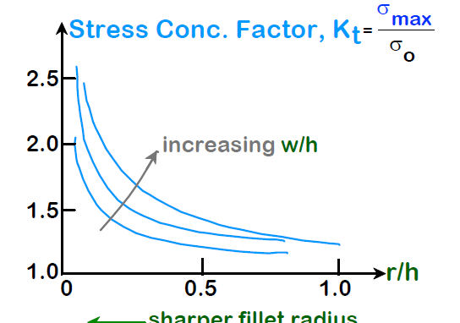
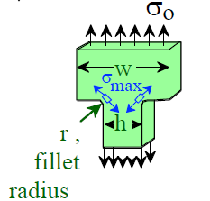
Stress Concentration
Large Kt promotes failure
Minimize crack size,a, and maximize radius of curvature, ρt, if crack is unavoidable
The applied stress is amplified @ microscopic defects & macroscopic internal discontinuities (e.g., voids or inclusions), & sharp corners, scratches, and notches
Avoid sharp corners!

Slide 16
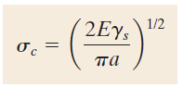
Stress Concentration
Critical stress (σc) for crack propagation in a brittle material
E : modulus of elasticity
γs : specific surface energy
a : one-half the length of an internal crack
All brittle materials contain a population of small cracks and flaws that have a variety of sizes, geometries, and orientations.When the magnitude of a tensile stress at the tip of one of these flaws exceeds the value of this critical stress, a crack forms and then propagates, which results in fracture.

Slide 17
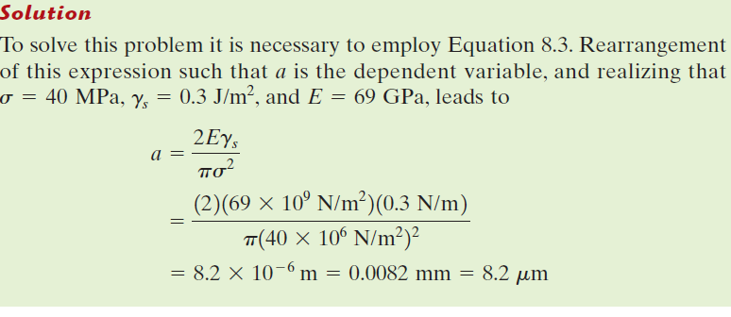
EXAMPLE PROBLEM: Maximum Flaw Length Computation
A relatively large plate of a glass is subjected to a tensile stress of 40 MPa. If the specific surface energy and modulus of elasticity for this glass are 0.3 J/m² and 69 GPa, respectively, determine the maximum length of a surface flaw that is possible without fracture.

Slide 18
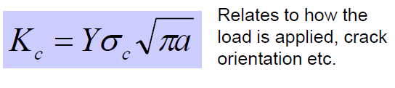
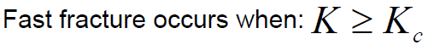
Fracture Toughness (Kc)
Fracture toughness: a property that is a measure of a material’s resistance to brittle fracture when a crack is present.
Fracture toughness—
dependence on
critical stress for
crack propagation
and crack length
(for a plate of infinite width having a through-thickness crack Y=1; whereas for a plate of semi-infinite width containing an edge crack of length a Y≈1.1)
In the presence of a crack, it is related to critical stress for crack propagation and depends on:
1) material size & geometry
2) crack dimension & orientation
3) the manner in which the load is applied

Slide 19
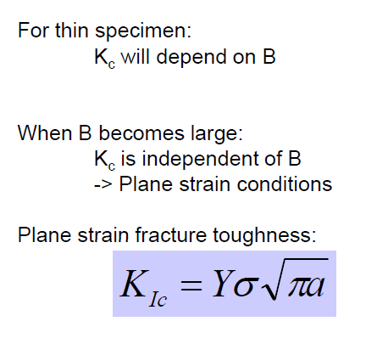
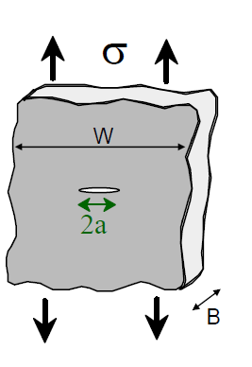
Fracture Toughness (Kc)
Kc will depend on specimen thickness
The Kc value for this thick-specimen situation is known as the plane strain fracture toughness KIc
KIc depends on temperature, strain rate, and microstructure.
Kıc ↓ when strain rate↑ and T↓.
Kıc ↑ when grain size ↓

Slide 20
Fracture Toughness Data for Selected Engineering Materials
Fracture testing of ceramics cannot be performed easily using a sharp notch, since
formation of such a notch often causes the samples to break. We can use hardness testing to gain a measure of the fracture toughness of many ceramics.

Slide 21
FRACTURE TOUGHNESS TESTING
Impact Testing Techniques
The results of laboratory tensile tests (at low loading rates) could not be extrapolated to predict fracture behavior.
Under some circumstances normally ductile metals fracture abruptly and
with very little plastic deformation under high loading rates.
Impact test conditions were chosen to represent those most severe relative to the potential for fracture namely, (1) deformation at a relatively low temperature, (2) a high strain rate (i.e., rate of deformation), and (3) a triaxial stress state (which may be introduced by the presence of a notch)
Two standardized tests,the Charpy and Izod, were designed and are still used
to measure the impact energy (sometimes also termed notch toughness).
Notes:
It was realized that the results of laboratory tensile tests
(at low loading rates) could not be extrapolated to predict fracture behavior.
Charpy V-notch (CVN) technique is most commonly used

Slide 22
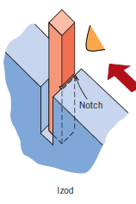
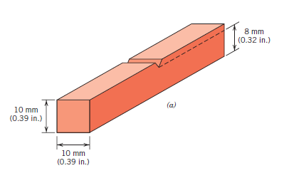
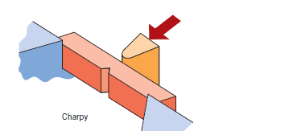
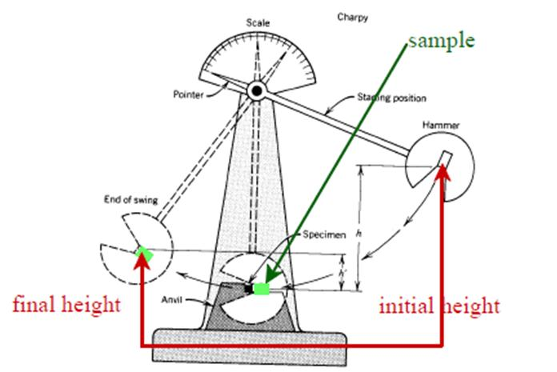
Specimen used
for Charpy and Izod
impact tests.
Specimen placements for both
Charpy and Izod tests
V-notch machined sample
Izod
Charpy
A schematic drawing of an impact testing apparatus. The hammer is released from fixed height h and strikes the specimen; the energy expended in fracture is reflected in the difference between h and the swing height h‘.

Slide 23
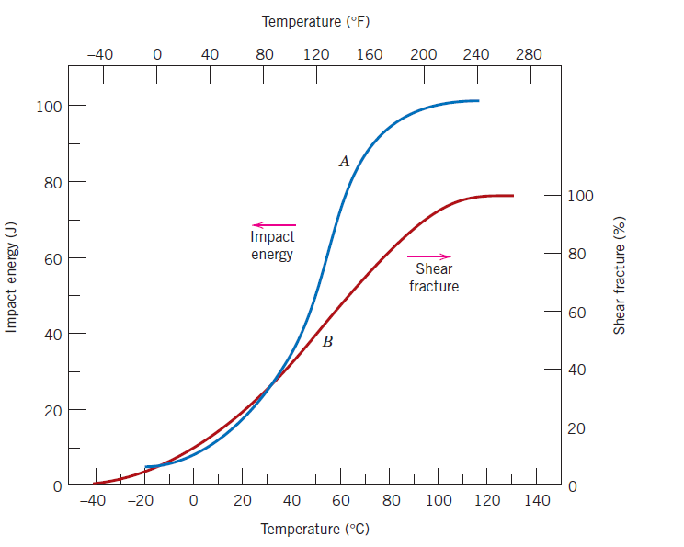
Ductile-to-Brittle Transition
One of the primary functions of Charpy and Izod tests is to determine whether a
material experiences a ductile-to-brittle transition with decreasing temperature
As temperature decreases a ductile material can become brittle - ductile-to-brittle transition
a ductile mode of fracture
a brittle mode of fracture
photograph of the fractured oil tanker made with steels can exhibit this ductile-to-brittle transition with disastrous consequences
Notes:
One of the primary functions of Charpy and Izod tests is to determine whether a
material experiences a ductile-to-brittle transition with decreasing temperature and,
if so, the range of temperatures over which it occurs.
As may be noted in the chapter opening
photograph of the fractured oil tanker for this chapter, widely used steels can
exhibit this ductile-to-brittle transition with disastrous consequences
At higher temperatures the CVN energy is relatively large, in correlation
with a ductile mode of fracture. As the temperature is lowered, the impact energy
drops suddenly over a relatively narrow temperature range, below which the
energy has a constant but small value; that is, the mode of fracture is brittle.

Slide 24
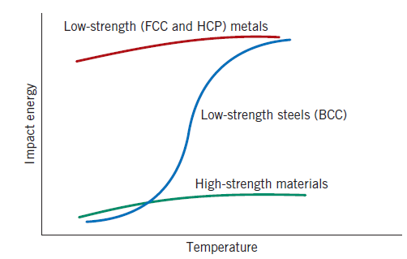
Ductile-to-Brittle Transition
Some Al and Cu alloys and most HCP metals don't experience a ductile to brittle translation
The characteristic ductile to brittle translation.
High strength Steel and Ti- alloys, these materials are very brittle because their low impact energy
Alloying usually increases the ductile-to-brittle transition temperature.
FCC metals remain ductile down to very low temperatures.
For ceramics, this type of transition occurs at much higher temperatures than for metals

Slide 25
FATIGUE (Failure under fluctuating / cyclic stresses)
Fatigue is a form of failure that occurs in structures subjected to dynamic and fluctuating stresses (e.g. bridges, aircraft, etc.)
occur at a stress level considerably lower than the tensile or yield strength for a static load
this type of failure normally occurs after a lengthy period of repeated stress or strain cycling
Estimated to causes 90% of all failures of metallic structures
Fatigue failure is brittle-like (relatively little plastic deformation) - even in normally ductile materials. Thus sudden and catastrophic!
Applied stresses causing fatigue may be axial (tension or compression), flextural (bending) or torsional (twisting).

Slide 26
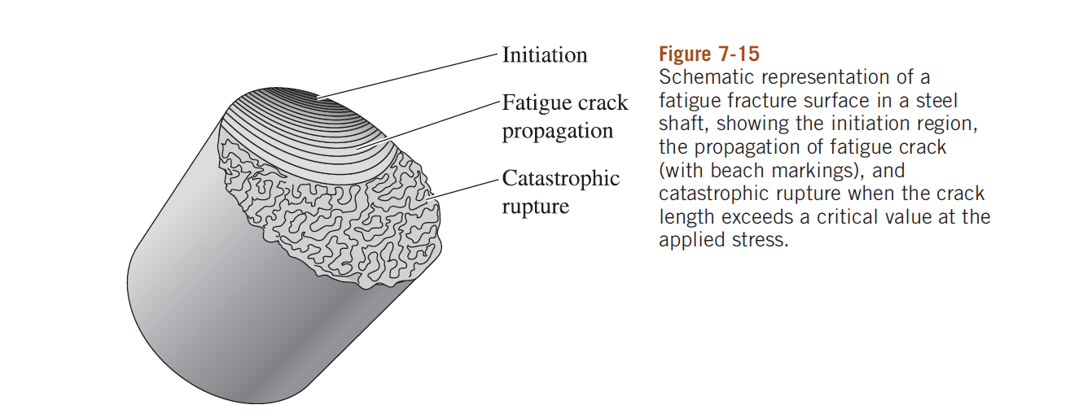
FATIGUE (Failure under fluctuating / cyclic stresses)
Fatigue failure proceeds in three distinct stages:
- tiny crack initiates or nucleates typically at the surface
- incremental crack propagation
- final catastrophic failure.
For fatigue to occur, at least part of the stress in the material has to be tensile!!!!!

Slide 27
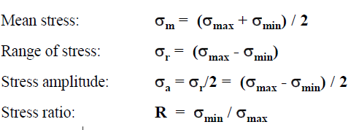
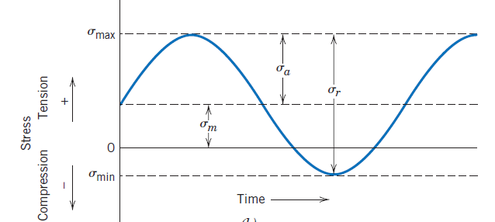
Fatigue: Cyclic Stresses
Cyclic stresses are characterized by maximum, minimum and mean stress, the range of stress, the stress amplitude, and the stress ratio
Remember the convention that tensile stresses are positive,
compressive stresses are negative

Slide 28
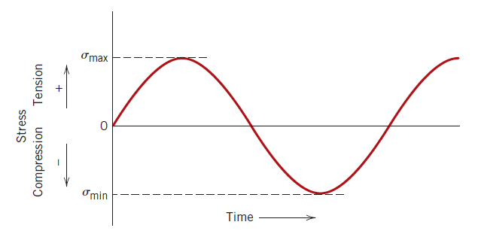
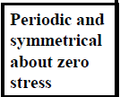
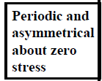
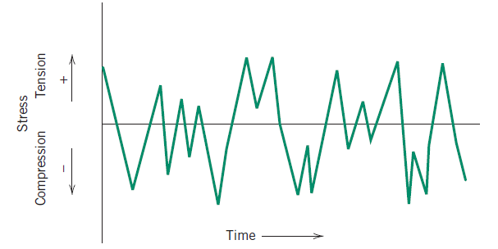
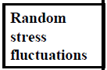
Fatigue: Cyclic Stresses
Variation of stress with time that accounts for fatigue failures.
Reversed stress cycle, in which the stress alternates from a maximum tensile stress (+) to a maximum
compressive stress (-) of equal magnitude.
Repeated stress cycle, in which maximum
and minimum stresses are asymmetrical
relative to the zero stress level; mean stress
σm, range of stress σr, and stress amplitude σa are indicated.
Random stress cycle

Slide 29
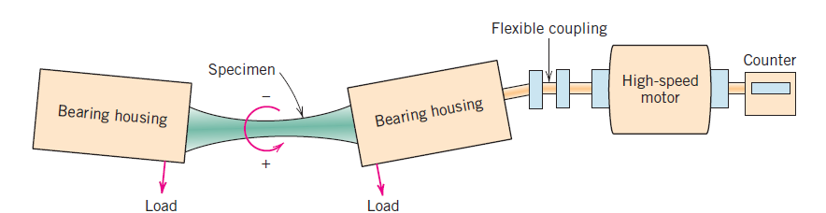
Fatigue: S—N curves
(stress-number of cycles to failure)
Fatigue properties of a material (S-N curves) are tested in rotating-bending tests in fatigue testing apparatus:
The stress cycling at a relatively large maximum stress amplitude (max), usually on the order of two-thirds of the static tensile strength
Result is commonly plotted as S (stress) vs. N (number of cycles to failure)
Low cycle fatigue: high loads, plastic and elastic deformation
High cycle fatigue: low loads, elastic deformation (N > 10⁵)

Slide 30
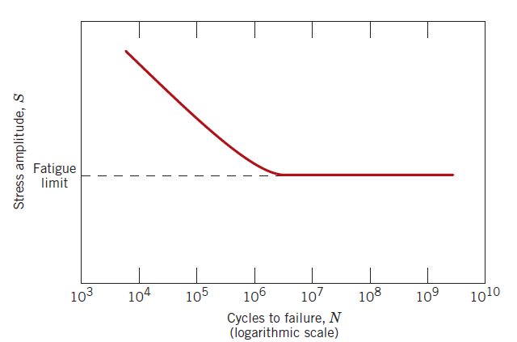
Fatigue: S—N curves
(stress-number of cycles to failure)
a material that displays a fatigue limit
Fatigue limit (endurance limit) occurs for some materials (some Fe and Ti allows). In this case, the S—N curve becomes horizontal at large N. The fatigue limit is a maximum stress amplitude below which the material never fails, no matter how large the number of cycles is.

Slide 31
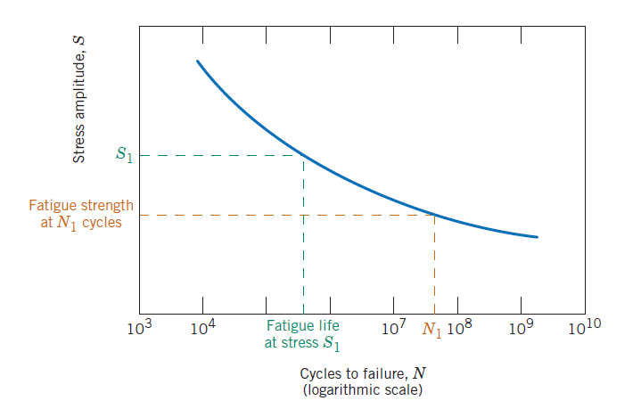
Fatigue: S—N curves
(stress-number of cycles to failure)
A material that does
not display a fatigue limit.
In nonferrous alloys (e.g., aluminum, copper, magnesium) , S decreases continuously with N. In this cases the fatigue properties are described by
Fatigue strength: stress at which fracture occurs after specified number of cycles (e.g. 10⁷)
Fatigue life: Number of cycles to fail at specified stress level

Slide 32
Crack initiation and propagation
Three stages of fatigue failure:
Crack initiation, wherein a small crack forms at some point of high stress concentration
Incremental crack propagation; during which this crack advances incrementally with each stress cycle
Final failure, which occurs very rapidly once the advancing crack has reached a critical size
Crack initiation
fatigue failure almost always initiate (or nucleate) on the surface of a component at some point of stress concentration.
Crack nucleation sites include surface scratches, sharp fillets, keyways, threads, dents, and the like.
Cyclic loading can produce microscopic surface discontinuities resulting from dislocation slip steps that may also act as stress raisers, and therefore as crack initiation sites.
Notes:
İncremental: artan

Slide 33
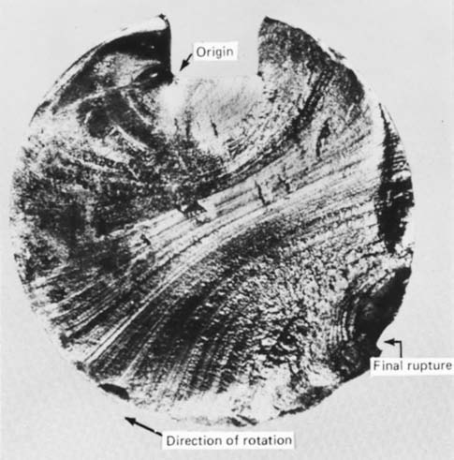

Crack initiation and propagation
Crack propagation
characterized by two types of markings termed beachmarks (“clamshell marks”) and striations
macroscopic dimensions-observable with the unaided eye
microscopic in size and subject to observation
with the electron microscope
Fracture surface of a rotating steel shaft that experienced fatigue failure. Beachmark ridges are visible in the photograph
Transmission electron fractograph showing fatigue striations in aluminum. 9000X

Slide 34

Fatigue failure surface. A crack formed at the top edge. The smooth region also near the top corresponds to the area over which the crack propagated slowly. Rapid failure occurred over the area having a dull and fibrous texture

Slide 35
FATIGUE (Failure under fluctuating / cyclic stresses)
In ceramics, we normally do not consider fatigue since ceramics typically fail because of their low fracture toughness.
Any fatigue cracks that may form will lower the useful life of the ceramic since it will cause the lowering of the fracture toughness. In general, we design ceramics for static (and not cyclic) loading.
Polymeric materials also show fatigue failure. The mechanism of fatigue in polymers is different than that in metallic materials.
In polymers, as the materials are subjected to repetitive stresses, considerable heating can occur near the crack tips and the inter-relationships between fatigue and another mechanism, known as creep

Slide 36

Factors that affect fatigue life
1- Mean Stress
increasing the mean stress
level leads to a decrease in fatigue life
Demonstration of the
influence of mean stress m on S–N
fatigue behavior.

Slide 37
Factors that affect fatigue life
2- Surface Effects
For many common loading situations, the maximum stress within a component or structure occurs at its surface. Consequently, most cracks leading to fatigue failure originate at surface positions.
fatigue life is especially sensitive to the condition and configuration of the component surface.
Solutions:
Polishing (removes machining flaws etc.)
Introducing compressive stresses (compensate for applied tensile stresses) into thin surface layer by “Shot Peening”- firing small shot into surface to be treated.
High-tech solution - ion implantation, laser peening.
Case Hardening - create C- or N- rich outer layer in steels by atomic diffusion from the surface. Makes harder outer layer and also introduces compressive stresses
Optimizing geometry - avoid internal corners, notches etc.

Slide 38

Factors that affect fatigue life
3- Environmental effects
a) Thermal Fatigue: Thermal cycling causes expansion and contraction, hence thermal stress, if component is restrained.
Thermal stress (σ)—dependence on coefficient of thermal expansion (α₁) , modulus of elasticity (E), and temperature change (ΔT)
Solutions:
eliminate restraint by design
use materials with low thermal expansion coefficients
b) Corrosion fatigue: Chemical reactions induce pits which act as stress raisers. Corrosion also enhances crack propagation.
Solutions:
decrease corrosiveness of medium, if possible
add protective surface coating
add residual compressive stresses

Slide 39

CREEP
Creep is the time-dependent and permanent deformation of materials when subjected to a constant load or stress.
For metals it becomes important only for temperatures greater than about 0.4Tm (Tm absolute melting temperature)
Examples: turbine rotors in jet engines and steam generators that experience centrifugal stresses, and high-pressure steam lines
Creep test: constant load or stress
while maintaining the temperature constant; deformation or strain is measured and plotted as a function of elapsed time.

Slide 40

Stages of creep
1.Instantaneous deformation, totally elastic.
2. Primary/transient creep. Slope of strain vs. time decreases with time: work-hardening
3. Secondary/steady-state creep. Rate of straining is constant: balance of work-hardening and recovery.
4. Tertiary. Rapidly accelerating strain rate up to failure: formation of internal cracks, voids, grain boundary separation, necking, etc.

Slide 41


Parameters of creep behavior
The stage secondary/steady-state creep is of longest duration and the steady-state creep rate έ=Δε/Δt is the most important parameter of the creep behavior in long-life applications.
Another parameter, especially important in short-life creep situations, is time to rupture, or the rupture lifetime, tr.
Dependence of creep strain rate on
stress and temperature (in K)
where Qc is the activation energy for creep, K₂ and n are material constants

Slide 42

Creep: stress and temperature effects
With increasing stress or temperature:
The instantaneous strain increases
The steady-state creep rate increases
The time to rupture decreases

Slide 43
To minimize creep…
First, we need to know what the possible mechanisms are.
Several mechanism suggested for creep.
• Stress-induced vacancy diffusion.
• Grain Boundary diffusion and sliding.
• Dislocation motion.
Each gives different slope for stress vs. creep rate.
Possible solutions:
• Use single crystals usually a costly solution.
• Increase grain size.
• Solid solutions.
• Precipitation hardening.

Slide 44
ALLOYS FOR HIGH-TEMPERATURE USE (turbines in jet engines, hypersonic airplanes, nuclear reactors, etc.)
Creep is generally minimized in materials with:
High melting temperature
High elastic modulus
Large grain sizes (inhibits grain boundary sliding) (smaller grains permit
more grain boundary sliding, which results in higher creep rates)
Following materials are especially resilient to creep:
Stainless steels
Refractory metals (containing elements of high melting point, like Nb, Mo, W, Ta)
“Superalloys” (Co, Ni based: solid solution hardening and secondary phases)

